Slide 1
Tooling intuition
Back 2 basics

Slide 2
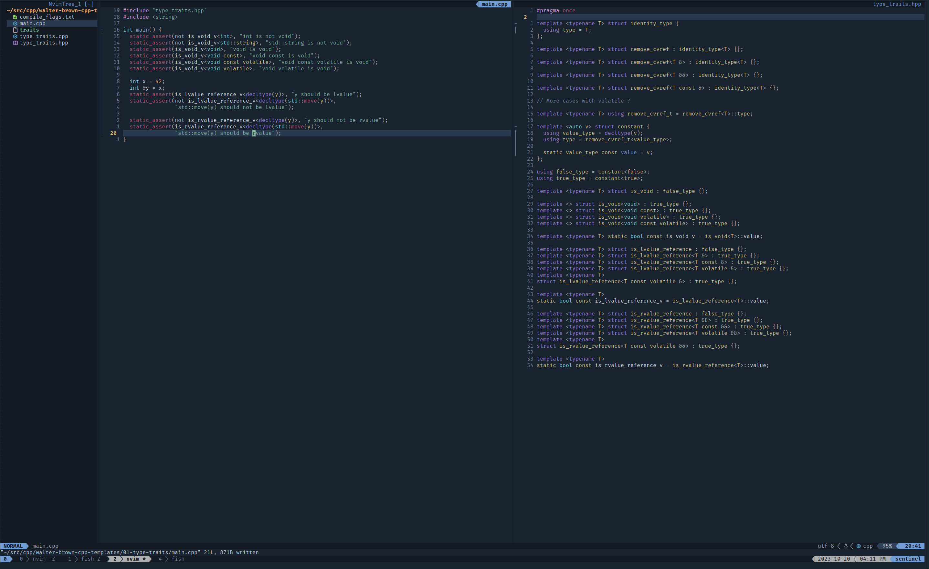
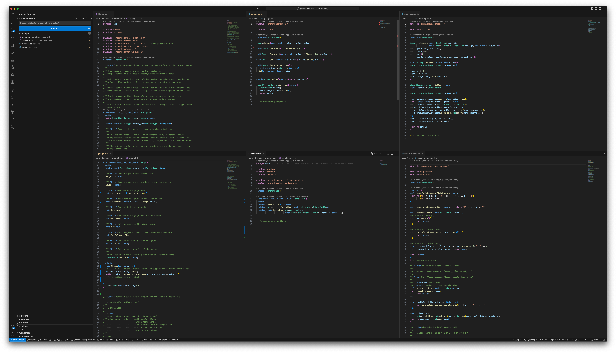
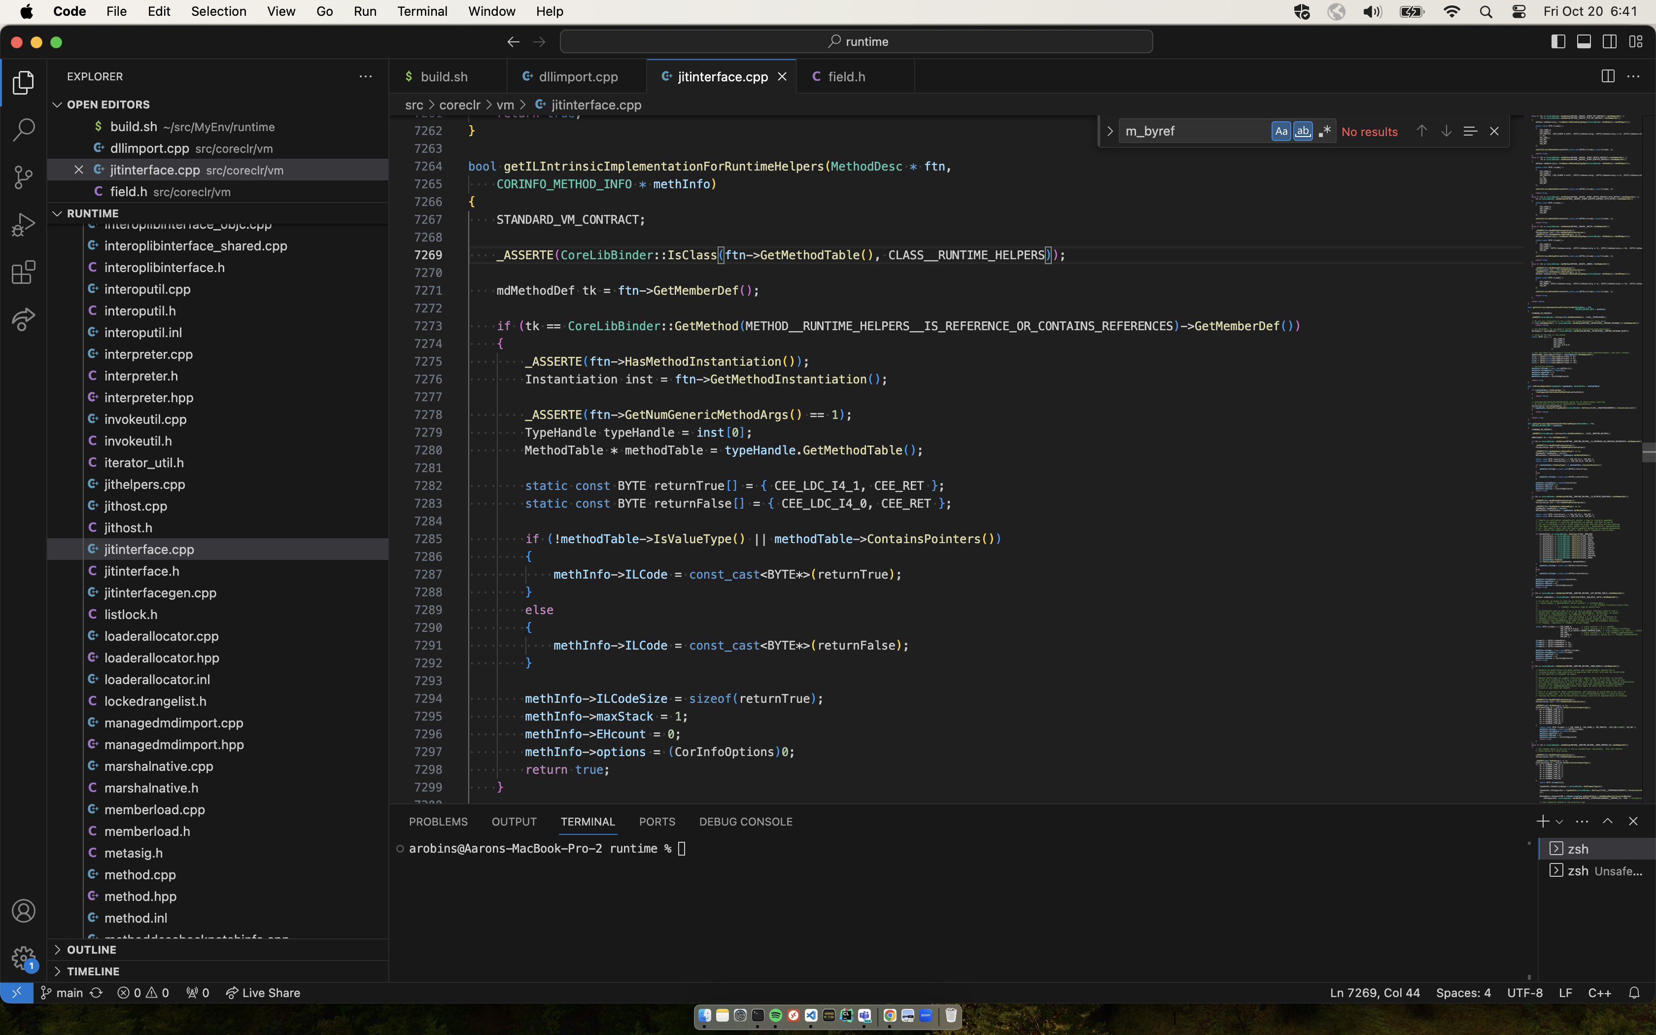
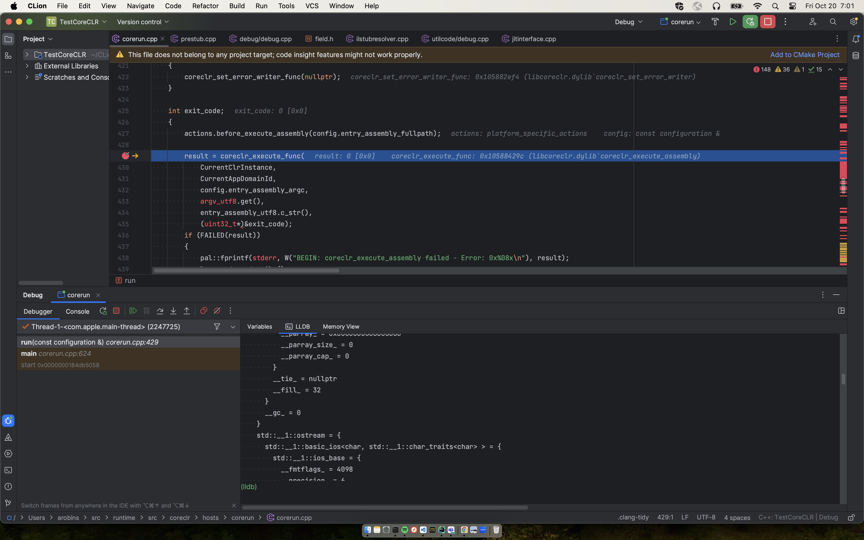
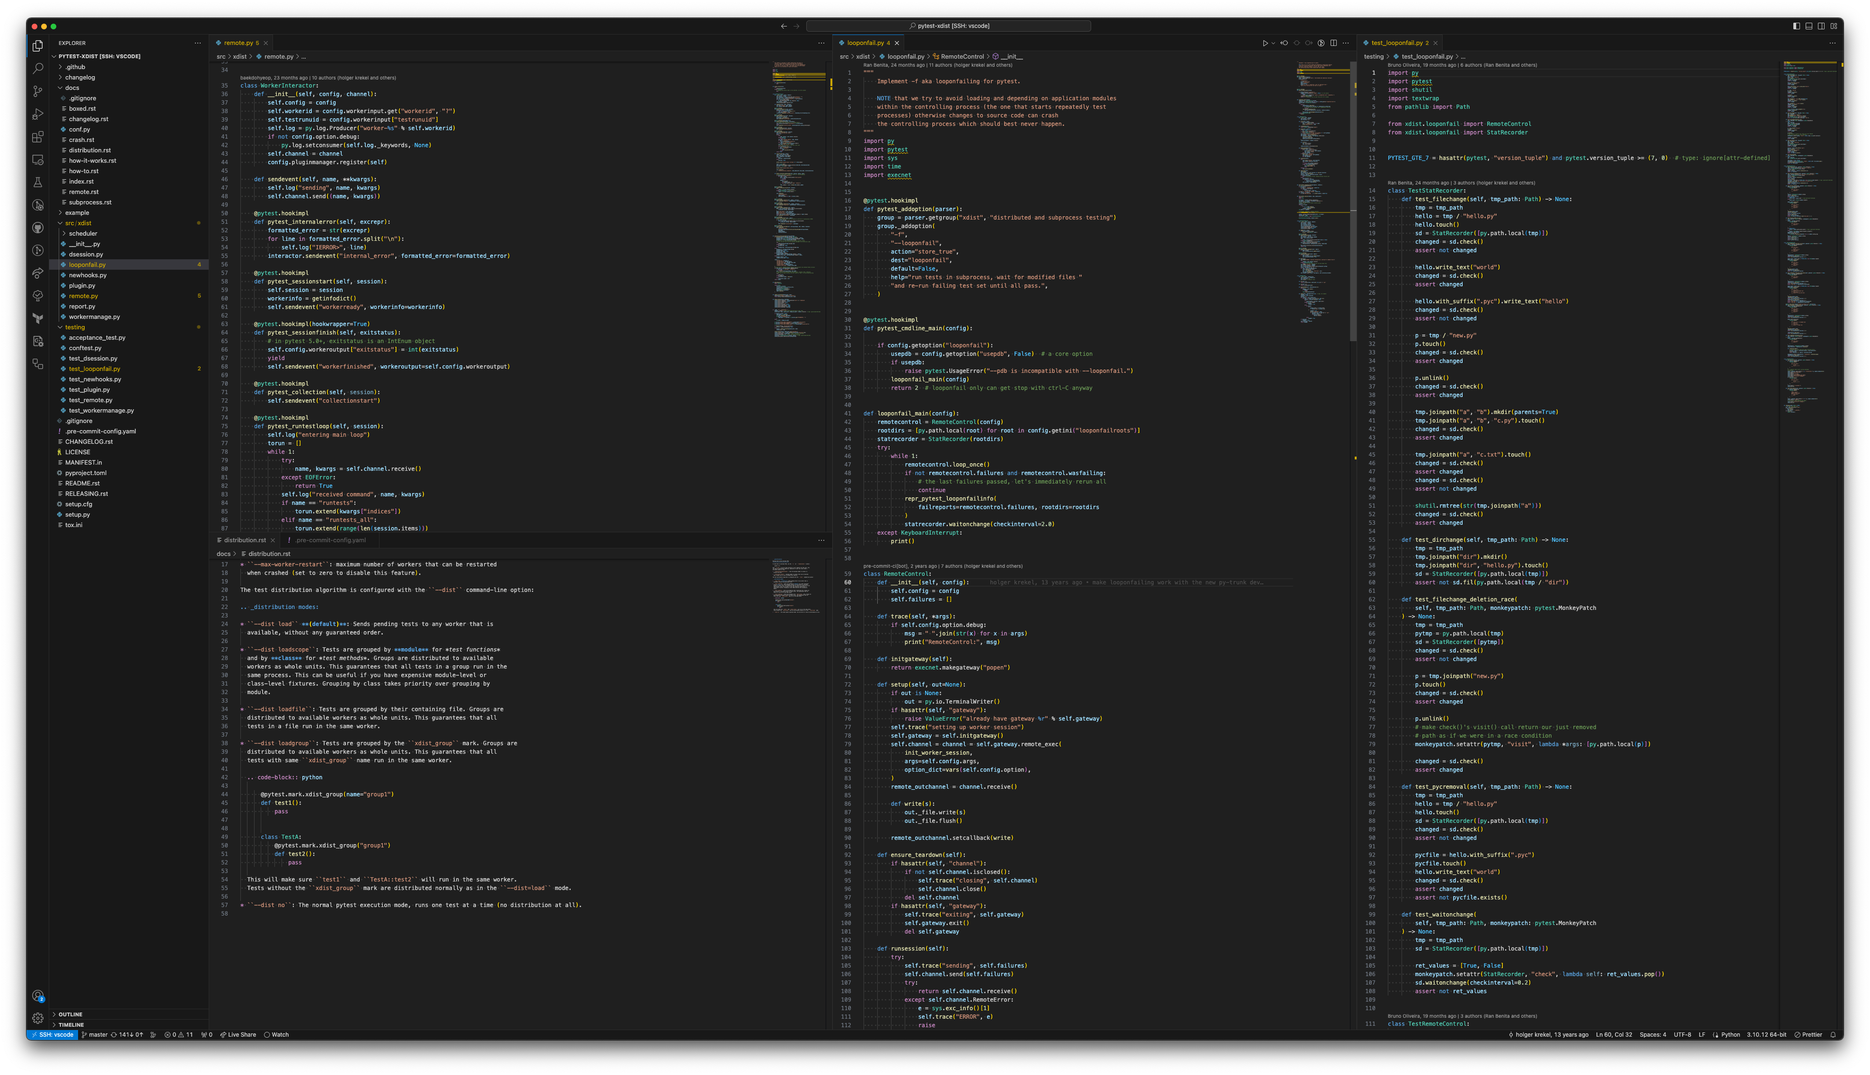
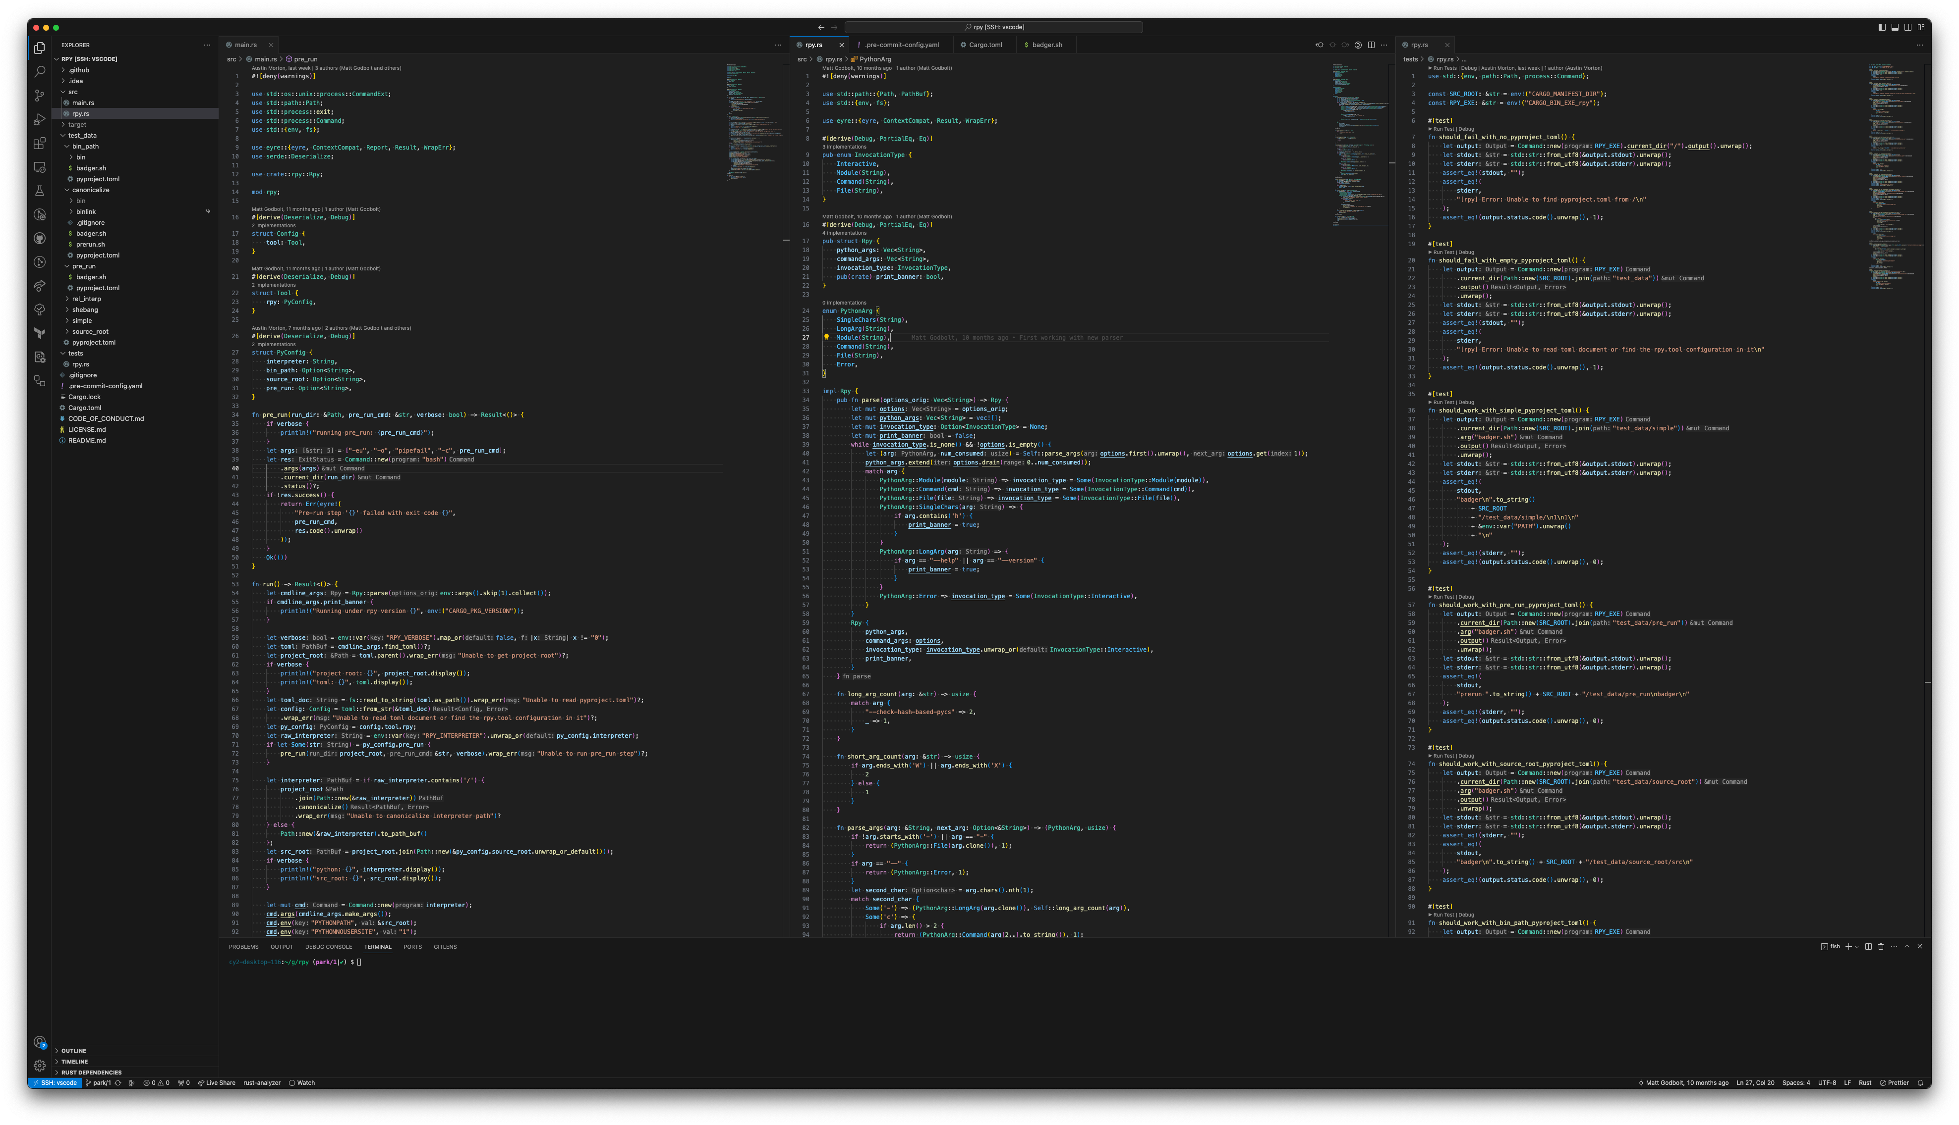

Slide 3
and
Many different interfaces
Multiple OS’s
Common Tools
Problems…

Slide 4
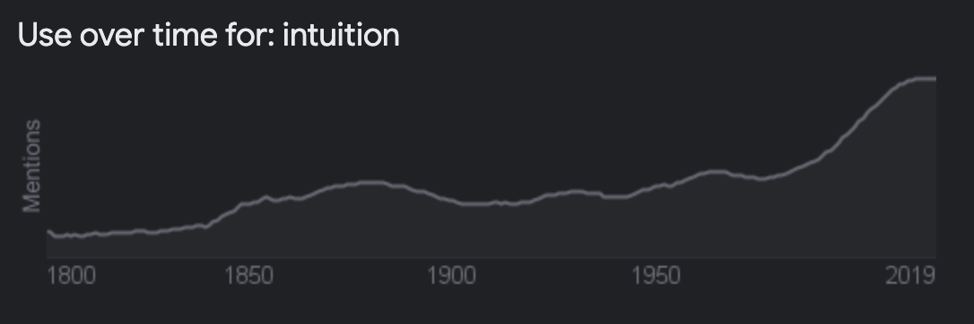
in·tu·i·tion /ˌinto͞oˈiSH(ə)n,ˌintəˈwiSH(ə)n/
noun
the ability to understand something immediately, without the need for conscious reasoning.
"we shall allow our intuition to guide us"
a thing that one knows or considers likely from instinctive feeling rather than conscious reasoning.
Similar: instinct intuitiveness sixth sense divination clairvoyance

Slide 5

squirrel!!!

Slide 6
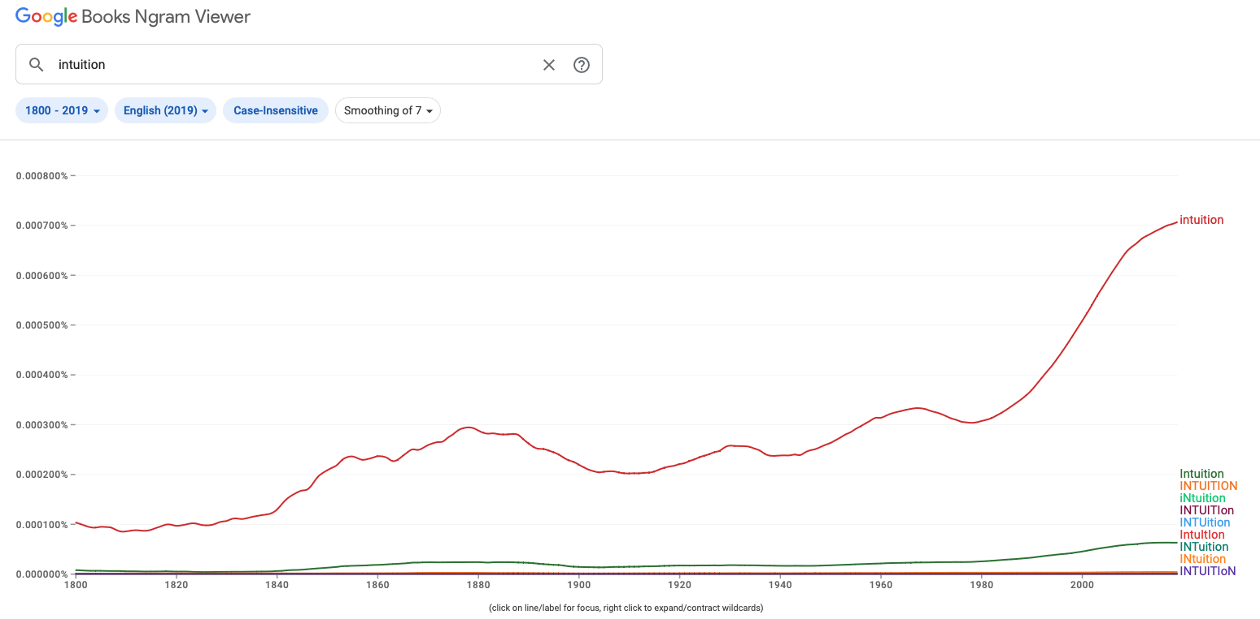
in·tu·i·tion /ˌinto͞oˈiSH(ə)n,ˌintəˈwiSH(ə)n/
1877
Notes:
So there was this graph on the use of intuition in books… which lead to.. 1877…

Slide 7
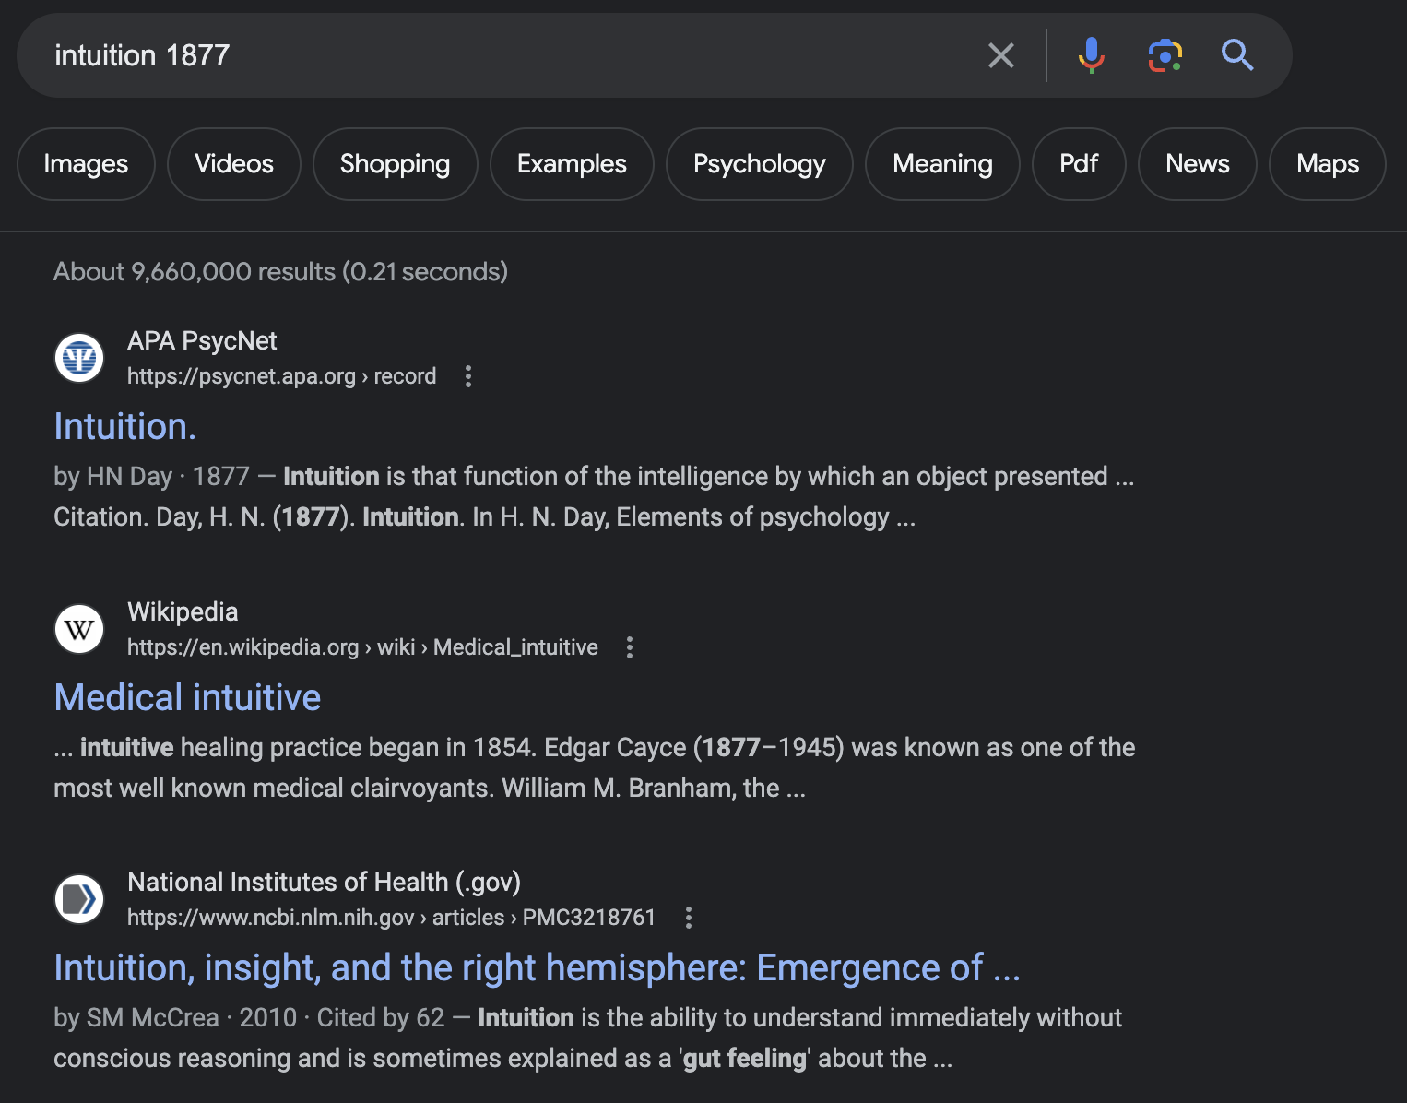
Google “intuition 1877”
Intuition is that function of the intelligence by which an object presented by the mind itself is apprehended.
H. N. Day
Notes:
That a-hah moment.

Slide 8
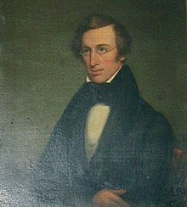
Henry noble day(1808 – 1890)
Intuition is that function of the intelligence by which an object presented by the mind itself is apprehended.
Elements of psychology • 1877 • (pp. 172–174) • G P Putnam's Sons
Notes:
Sir William David Ross…

Slide 9
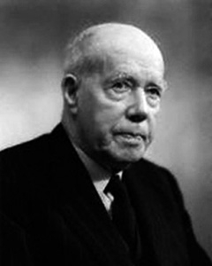
William david ross (1877 – 1971)
Father of Intuitionism.
Intuitionism is the epistemological view that some moral truths can be known without logical inference or systematic thought; such truths, it is argued, can be known directly either through a “moral sense” (the empiricist view) or by means of non-empirical a priori knowledge (the rationalist view).
The Intuitionism is the epistemological view that some moral truths can be known without logical inference or systematic thought; such truths, it is argued, can be known directly either through a “moral sense” (the empiricist view) or by means of non-empirical a priori knowledge (the rationalist view).
SCIENCE • 5 May 1967 • Vol 156, Issue 3775 • pp. 605-610
Notes:
Sir William David Ross… intuition is listed 741 times in 641 pages…

Slide 10
William david ross (1877 – 1971)
Father of Intuitionism.
Intuitionism is the epistemological view that some moral truths can be known without logical inference or systematic thought; such truths, it is argued, can be known directly either through a “moral sense” (the empiricist view) or by means of non-empirical a priori knowledge (the rationalist view).
SCIENCE • 5 May 1967 • Vol 156, Issue 3775 • pp. 605-610
Notes:
Sir William David Ross… intuition is listed 741 times in 641 pages…

Slide 11
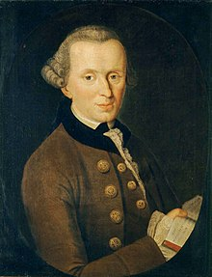
Immanuel Kant (1724 – 1804)
The mere form of intuition, without substance, is in itself no object, but the merely formal condition of an object (as phenomenon), as pure space and pure time. These are certainly something, as forms of intuition, but are not themselves objects which are intuited (ens imaginarium).
Thoughts without content are void; intuitions without conceptions, blind.
Rules for Happiness: something to do, someone to love, something to hope for.
The critique of pure reason • 1787• Second Edition
Notes:
Sir William David Ross… intuition is listed 741 times in 641 pages…

Slide 12
Immanuel Kant (1724 – 1804)
The mere form of intuition, without substance, is in itself no object, but the merely formal condition of an object (as phenomenon), as pure space and pure time.
Thoughts without content are void; intuitions without conceptions, blind.
Rules for Happiness: something to do, someone to love, something to hope for.
The critique of pure reason • 1787• Second Edition
Notes:
Sir William David Ross… intuition is listed 741 times in 641 pages…

Slide 13
in·tu·i·tion /ˌinto͞oˈiSH(ə)n,ˌintəˈwiSH(ə)n/
1877
1967

Slide 14

Google “intuition 1967”
The major role of intuition is to provide a conceptual foundation that suggests the directions which new research should take.
R.L. Wilder
Notes:
Research = debugging

Slide 15
Google “intuition 1967”
"Intuition," as used by the modern mathematician, means an accumulation of attitudes (including beliefs and opinions) derived from experience, both individual and cultural.

Slide 16
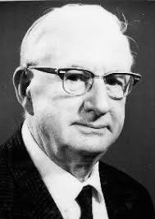
Raymond Luis Wilder (1896 – 1982)
The role of intuition in research is to provide the "educated guess," which may prove to be true or false; but in either case, progress cannot be made without it and even a false guess may lead to progress.
The ultimate basis of modern mathematics is thus mathematical intuition. and it is in this sense that the Intuitionistic doctrine of Brouwer and his followers is correct. Modern instructional methods recognize this role of intuition by replacing the "do this, do that" mode of teaching by a "what should be done next?"
SCIENCE • 5 May 1967 • Vol 156, Issue 3775 • pp. 605-610

Slide 17
Raymond Luis Wilder (1896 – 1982)
The role of intuition in research is to provide the "educated guess," which may prove to be true or false; but in either case, progress cannot be made without it and even a false guess may lead to progress.
"Intuition," as used by the modern mathematician, means an accumulation of attitudes (including beliefs and opinions) derived from experience, both individual and cultural.
SCIENCE • 5 May 1967 • Vol 156, Issue 3775 • pp. 605-610

Slide 18
the parameters...
mathematically
Using byte = unsigned char;
int contrived( byte a, byte b) {
…
}
A = 256
B = 256
65,536 Possibilities
Notes:
The point here is to make them look at the mathematical variations of the parameters, reasoning about possibilities.

Slide 19

The latest dance song had Intuition in the title…

Slide 20
in·tu·i·tion /ˌinto͞oˈiSH(ə)n,ˌintəˈwiSH(ə)n/
2019
1877
1967

Slide 21

Google “intuition 2019”
Red, red wine Stay close to me Don't let me be alone It's tearin' apart My blue, blue heart
Source: UB40

Slide 22

Google “intuition 2019”
Source: www.vinology.com

Slide 23
Intuition – key points
Matters most to me when I am working on unfamiliar (a colleagues) code.

Slide 25
and
Many different interfaces
Multiple OS’s
Common Tools
Problems…

Slide 26









Interfaces

Slide 27



compilers

Slide 28
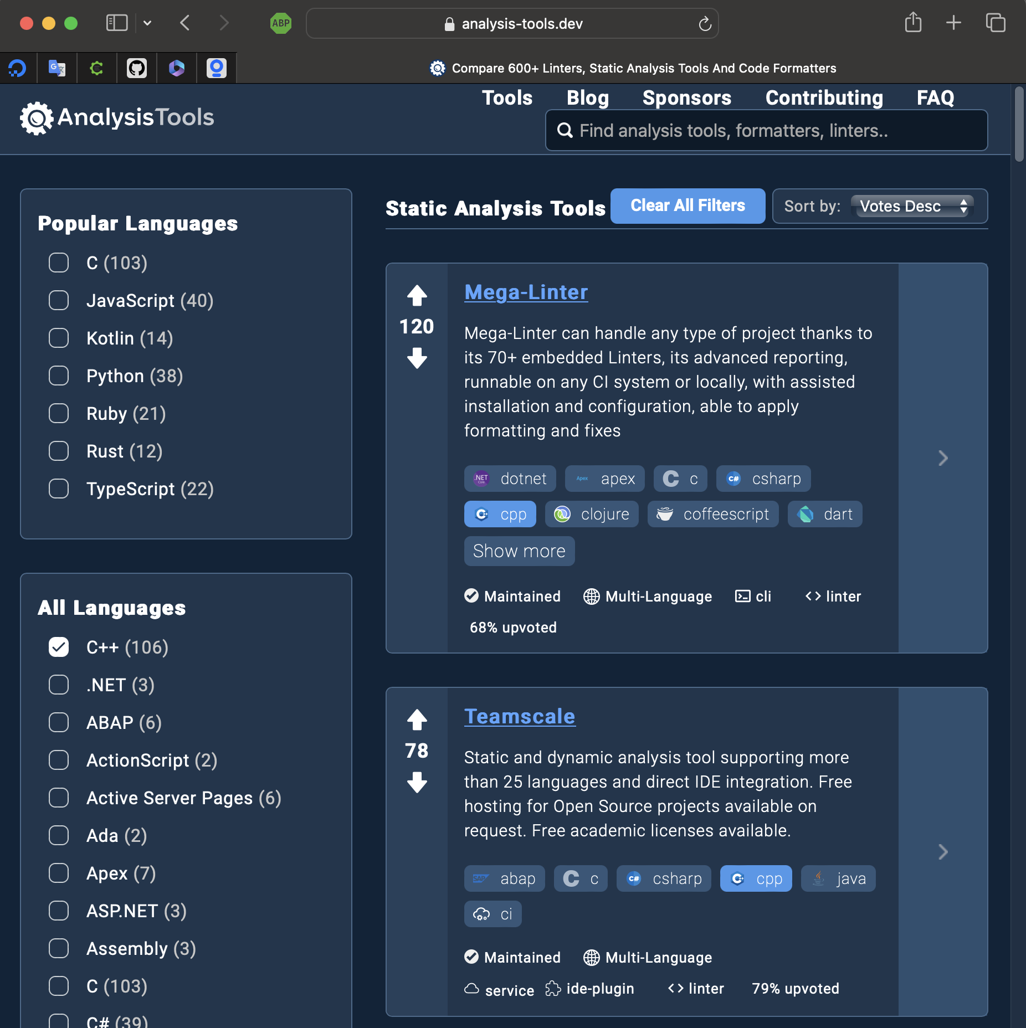




Static analyzers
https://analysis-tools.dev/

Slide 29

A few static analysis tools…

Slide 30
Are they doing all they can for you?
How well do you use them?

Slide 31
3 types of problems (at least…)
Compile time
Syntax errors (violate standard, or that which is implemented in the compiler)
Templates ☺
Link time
Missing libraries
Versioning issues
Run time
Logical errors
Semantic errors (uninitialized values – correct statements that don’t make sense)

Slide 32
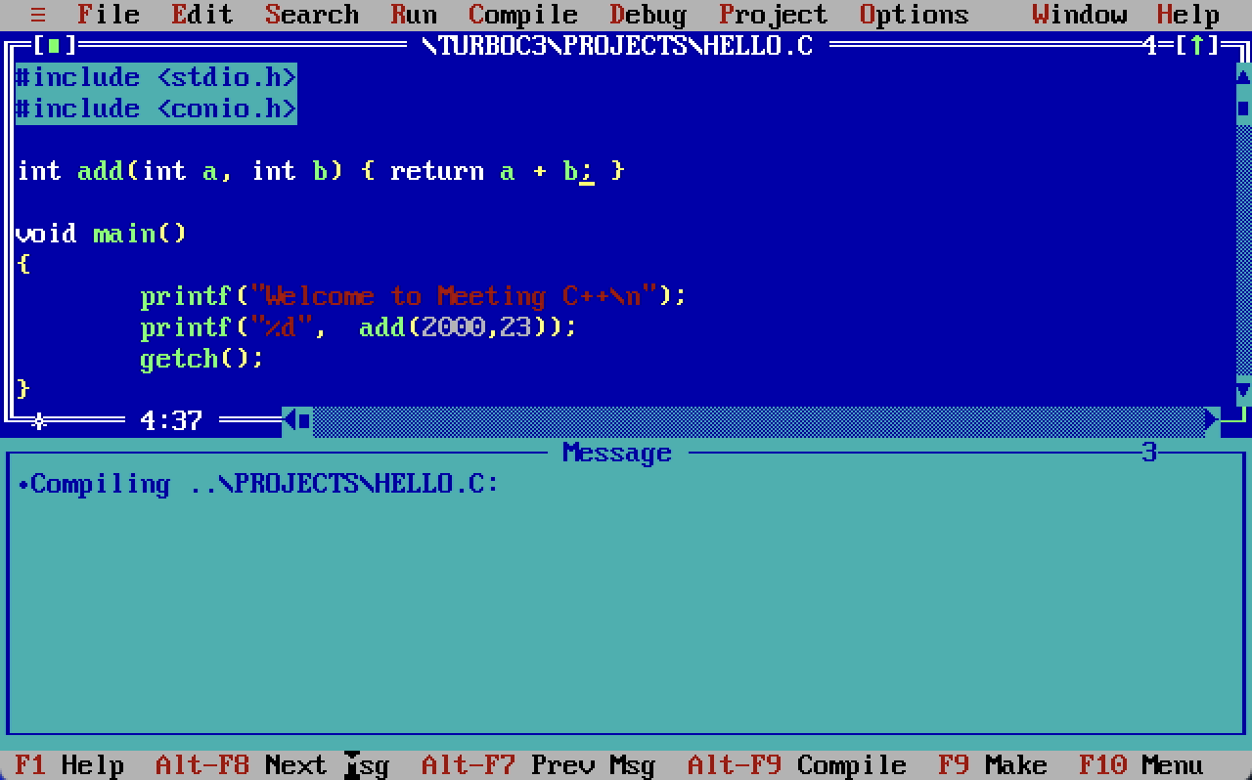
Compilers of yore…

Slide 33
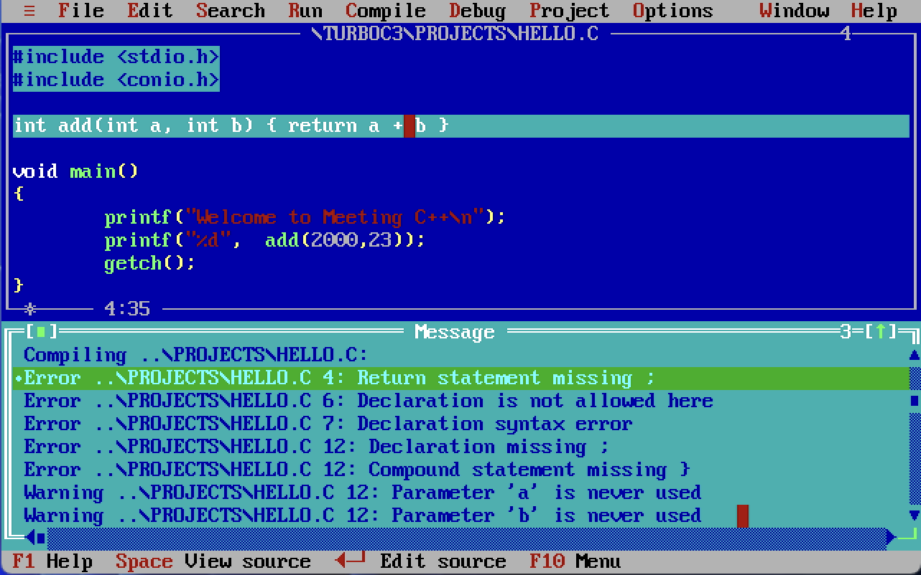
Compile time errors of old…

Slide 34
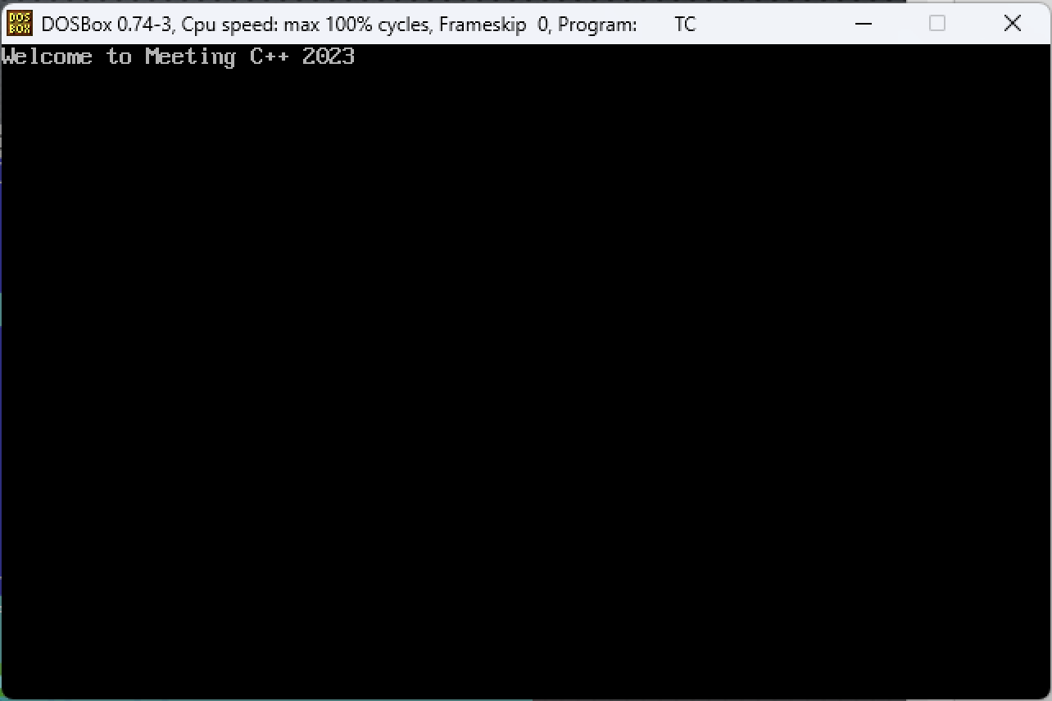
Compile time errors of old…
Code like it’s the 90’s

Slide 35

Compile time errors
#include <iostream>
int main() {
std::cout << "Welcome to Meeting C++ 2023\n" return 0;
}
X86-64 gcc 4.6.4
Compiler options…
<source>: In function 'int main()':
<source>:5:5: error: expected ';' before 'return'

Slide 36
Compile time errors
#include <iostream>
int main() {
std::cout << "Welcome to Meeting C++ 2023\n" ;return 0;
}
X86-64 gcc 4.6.4
Compiler options…
Welcome to Meeting C++ 2023
Notes:
It works but probably not where we want to be literally putting our semicolons.

Slide 37
Compile time errors
#include <iostream>
int main() {
std::cout << "Welcome to Meeting C++\n" return 0;
}
X86-64 clang 3.3
Compiler options…
<source>:4:44: error: expected ';' after expression
std::cout << "Welcome to Meeting C++\n"
^
;
1 error generated.
Notes:
Clang had better error reporting from the beginning. Different tools can give you more information.

Slide 38
Compile time errors
#include <iostream>
int main() {
std::cout << "Welcome to Meeting C++\n" return 0;
}
X86-64 clang 17.0.1
Compiler options…
<source>:4:44: error: expected ';' after expression
4 | std::cout << "Welcome to Meeting C++\n"
| ^
| ;
1 error generated.
Notes:
Clang had better error reporting from the beginning. Different tools can give you more information.

Slide 39
Compile time errors
#include <iostream>
int main() {
std::cout << "Welcome to Meeting C++\n" return 0;
}
X86-64 gcc (trunk)
Compiler options…
<source>: In function 'int main()':
<source>:4:44: error: expected ';' before 'return'
4 | std::cout << "Welcome to Meeting C++\n"
| ^
| ;
5 | return 0;
| ~~~~~~
Notes:
Clang had better error reporting from the beginning. Different tools can give you more information.

Slide 40
Compile time errors - standards
#include <iostream>
#include <functional>
int main() {
[out = std::ref(std::cout << "Welcome to ")](){ out.get() << "Meeting C++ 2023\n"; }();
return 0;
}
X86-64 clang 3.7
Compiler options…
<source>:5:2: error: expected expression
[out = std::ref(std::cout << "Welcome to ")](){ out.get() << "Meeting C++ 2023\n"; }();
^
1 error generated.
Notes:
Clang had better error reporting from the beginning. Different tools can give you more information.

Slide 41
Compile time errors - standards
#include <iostream>
#include <functional>
int main() {
[out = std::ref(std::cout << "Welcome to ")](){ out.get() << "Meeting C++ 2023\n"; }();
return 0;
}
X86-64 clang 3.7
-std=c++14
Welcome to Meeting C++ 2023
Notes:
Clang had better error reporting from the beginning. Different tools can give you more information.

Slide 42
3 types of problems (at least…)
Compile time
Syntax errors (violate standard, or that which is implemented in the compiler)
Templates
Link time
Missing libraries
Versioning issues
Run time
Logical errors
Semantic errors (uninitialized values – correct statements that don’t make sense)

Slide 43
template errors
Do you love templates?

Slide 44
Template errors
#include <vector> #include <algorithm>
int main() { int a; std::vector< std::vector <int> > v; std::find( v.begin(), v.end(), a ); }
X86-64 gcc 4.9.4
-std=c++14
/opt/compiler-explorer/gcc-4.9.4/include/c++/4.9.4/bits/stl_algobase.h:71:0,
from /opt/compiler-explorer/gcc-4.9.4/include/c++/4.9.4/vector:60,
from <source>:1:
/opt/compiler-explorer/gcc-4.9.4/include/c++/4.9.4/bits/predefined_ops.h: In instantiation of 'bool __gnu_cxx::__ops::_Iter_equals_val<_Value>::operator()(_Iterator) [with _Iterator = __gnu_cxx::__normal_iterator<std::vector<int>*, std::vector<std::vector<int> > >; _Value = const int]':
/opt/compiler-explorer/gcc-4.9.4/include/c++/4.9.4/bits/stl_algo.h:120:22: required from '_RandomAccessIterator std::__find_if(_RandomAccessIterator, _RandomAccessIterator, _Predicate, std::random_access_iterator_tag) [with _RandomAccessIterator = __gnu_cxx::__normal_iterator<std::vector<int>*, std::vector<std::vector<int> > >; _Predicate = __gnu_cxx::__ops::_Iter_equals_val<const int>]'
/opt/compiler-explorer/gcc-4.9.4/include/c++/4.9.4/bits/stl_algo.h:162:43: required from '_Iterator std::__find_if(_Iterator, _Iterator, _Predicate) [with _Iterator = __gnu_cxx::__normal_iterator<std::vector<int>*, std::vector<std::vector<int> > >; _Predicate = __gnu_cxx::__ops::_Iter_equals_val<const int>]'
/opt/compiler-explorer/gcc-4.9.4/include/c++/4.9.4/bits/stl_algo.h:3780:50: required from '_IIter std::find(_IIter, _IIter, const _Tp&) [with _IIter = __gnu_cxx::__normal_iterator<std::vector<int>*, std::vector<std::vector<int> > >; _Tp = int]'
<source>:7:38: required from here
/opt/compiler-explorer/gcc-4.9.4/include/c++/4.9.4/bits/predefined_ops.h:191:17: error: no match for 'operator==' (operand types are 'std::vector<int>' and 'const int')
{ return *__it == _M_value; }
^
/opt/compiler-explorer/gcc-4.9.4/include/c++/4.9.4/bits/predefined_ops.h:191:17: note: candidates are:
Notes:
Clang had better error reporting from the beginning. Different tools can give you more information.

Slide 45
Template errors
#include <vector> #include <algorithm>
int main() { int a; std::vector< std::vector <int> > v; std::find( v.begin(), v.end(), a ); }
X86-64 clang (trunk)
-std=c++14
In file included from <source>:1:
In file included from /opt/compiler-explorer/gcc-snapshot/lib/gcc/x86_64-linux-gnu/14.0.0/../../../../include/c++/14.0.0/vector:62:
In file included from /opt/compiler-explorer/gcc-snapshot/lib/gcc/x86_64-linux-gnu/14.0.0/../../../../include/c++/14.0.0/bits/stl_algobase.h:71:
/opt/compiler-explorer/gcc-snapshot/lib/gcc/x86_64-linux-gnu/14.0.0/../../../../include/c++/14.0.0/bits/predefined_ops.h:270:17: error: invalid operands to binary expression ('std::vector<int>' and 'const int')
270 | { return *__it == _M_value; }
| ~~~~~ ^ ~~~~~~~~
Notes:
Clang had better error reporting from the beginning. Different tools can give you more information.

Slide 46
template errors
Do you -Wall?

Slide 47
Template errors
#include <vector> #include <algorithm>
int main() { int a; std::vector< std::vector <int> > v; std::find( v.begin(), v.end(), a ); }
X86-64 clang (trunk)
-std=c++14
In file included from <source>:1:
In file included from /opt/compiler-explorer/gcc-snapshot/lib/gcc/x86_64-linux-gnu/14.0.0/../../../../include/c++/14.0.0/vector:62:
In file included from /opt/compiler-explorer/gcc-snapshot/lib/gcc/x86_64-linux-gnu/14.0.0/../../../../include/c++/14.0.0/bits/stl_algobase.h:71:
/opt/compiler-explorer/gcc-snapshot/lib/gcc/x86_64-linux-gnu/14.0.0/../../../../include/c++/14.0.0/bits/predefined_ops.h:270:17: error: invalid operands to binary expression ('std::vector<int>' and 'const int')
270 | { return *__it == _M_value; }
| ~~~~~ ^ ~~~~~~~~
Notes:
Clang had better error reporting from the beginning. Different tools can give you more information.

Slide 48
Template errors
#include <vector> #include <algorithm>
int main() { int a; std::vector< std::vector <int> > v; std::find( v.begin(), v.end(), a ); }
X86-64 clang (trunk)
-std=c++14 -Wall
<source>:7:36: warning: variable 'a' is uninitialized when passed as a const reference argument here [-Wuninitialized-const-reference]
7 | std::find( v.begin(), v.end(), a );
| ^
In file included from <source>:1:
In file included from /opt/compiler-explorer/gcc-snapshot/lib/gcc/x86_64-linux-gnu/14.0.0/../../../../include/c++/14.0.0/vector:62:
In file included from /opt/compiler-explorer/gcc-snapshot/lib/gcc/x86_64-linux-gnu/14.0.0/../../../../include/c++/14.0.0/bits/stl_algobase.h:71:
/opt/compiler-explorer/gcc-snapshot/lib/gcc/x86_64-linux-gnu/14.0.0/../../../../include/c++/14.0.0/bits/predefined_ops.h:270:17: error: invalid operands to binary expression ('std::vector<int>' and 'const int')
270 | { return *__it == _M_value; }
| ~~~~~ ^ ~~~~~~~~
Notes:
Clang had better error reporting from the beginning. Different tools can give you more information.

Slide 49
Template errors FIX
#include <vector> #include <algorithm>
int main() { std::vector<int> a; std::vector< std::vector <int> > v; std::find( v.begin(), v.end(), a ); }
X86-64 clang (trunk)
-std=c++14
Program returned: 0
Notes:
Clang had better error reporting from the beginning. Different tools can give you more information.

Slide 50
Compiler warnings and options
Everyone should…
-Wall -Wextra -pedantic
https://gcc.gnu.org/onlinedocs/gcc/Warning-Options.html

Slide 51
Compiler warnings and options
In fact, everyone should…
https://github.com/cpp-best-practices/

Slide 52
Compiler settings
Clang/gcc – are you using?
-Wall -Wwarn -Werrors -Wextra -std=c++11 -pedantic-errors

Slide 53
3 types of problems (at least…)
Compile time
Syntax errors (violate standard, or that which is implemented in the compiler)
Templates
Link time
Missing libraries
Versioning issues
Cannot find symbols
Run time
Logical errors
Semantic errors (uninitialized values – correct statements that don’t make sense)

Slide 54
linker errors
Missing libraries
Versioning issues
Cannot find symbols

Slide 55
linker errors?
struct A { virtual ~A() = 0; }; struct B: A { virtual ~B(){} }; extern int x; void foo(); int main() { x = 0; foo(); B b; }
X86-64 gcc 4.9.4
-Wall -Wextra
Compiler returned: 0
Notes:
Wow, it compiles clean?

Slide 56
linker errors?
struct A { virtual ~A() = 0; }; struct B: A { virtual ~B(){}}; extern int x; void foo(); int main() { x = 0; foo(); B b; }
X86-64 gcc (trunk)
-Wall -Wextra
/opt/compiler-explorer/gcc-trunk-20231113/bin/../lib/gcc/x86_64-linux-gnu/14.0.0/../../../../x86_64-linux-gnu/bin/ld: /tmp/ccmt7oUg.o: in function `main':
<source>:6: undefined reference to `x'
/opt/compiler-explorer/gcc-trunk-20231113/bin/../lib/gcc/x86_64-linux-gnu/14.0.0/../../../../x86_64-linux-gnu/bin/ld: <source>:7: undefined reference to `foo()'
/opt/compiler-explorer/gcc-trunk-20231113/bin/../lib/gcc/x86_64-linux-gnu/14.0.0/../../../../x86_64-linux-gnu/bin/ld: /tmp/ccmt7oUg.o: in function `B::~B()':
<source>:2: undefined reference to `A::~A()'
collect2: error: ld returned 1 exit status
Compiler returned: 1
Notes:
A is pure virtual, X is marked external but doesn’t exist and Foo() has no definition, though it is forward declared.

Slide 57
linker errors?
struct A { virtual ~A() = 0; }; struct B: A { virtual ~B(){}}; extern int x; void foo(); int main() { x = 0; foo(); B b; }
X86-64 clang (trunk)
-Wall -Wextra
/opt/compiler-explorer/gcc-snapshot/lib/gcc/x86_64-linux-gnu/14.0.0/../../../../x86_64-linux-gnu/bin/ld: /tmp/example-afd2bd.o: in function `main':
<source>:6: undefined reference to `x'
/opt/compiler-explorer/gcc-snapshot/lib/gcc/x86_64-linux-gnu/14.0.0/../../../../x86_64-linux-gnu/bin/ld: <source>:7: undefined reference to `foo()'
/opt/compiler-explorer/gcc-snapshot/lib/gcc/x86_64-linux-gnu/14.0.0/../../../../x86_64-linux-gnu/bin/ld: /tmp/example-afd2bd.o: in function `B::~B()':
<source>:2: undefined reference to `A::~A()'
clang++: error: linker command failed with exit code 1 (use -v to see invocation)
Compiler returned: 1
Notes:
Clang does not show much difference here from GCC. Different types of linker issues
Reasoning about them
Differences between OS

Slide 58
3 types of problems (at least…)
Compile time
Syntax errors (violate standard, or that which is implemented in the compiler)
Templates
Link time
Missing libraries
Versioning issues
Cannot find symbols
Run time
Logical errors
Semantic errors (uninitialized values – correct statements that don’t make sense)

Slide 59
Run time errors
What the compiler doesn’t catch…
Logical errors
Semantic errors (uninitialized values – correct statements that don’t make sense)

Slide 60
semantic errors
#include <iostream> #include <vector> int product(std::vector<int>& numbers) { int product; for (int n : numbers) { product *= n; } return product; } int main() { std::vector<int> numbers = {1, 2, 3, 4, 5}; std::cout << "Product: " << product(numbers) << std::endl; return 0; }
X86-64 gcc (trunk)
-Wall -Wextra -Werror
Program returned: 0
Product: 0
Notes:
Clang had better error reporting from the beginning. Different tools can give you more information.

Slide 61
semantic errors
#include <iostream> #include <vector> int product(std::vector<int>& numbers) { int product; for (int n : numbers) { product *= n; } return product; } int main() { std::vector<int> numbers = {1, 2, 3, 4, 5}; std::cout << "Product: " << product(numbers) << std::endl; return 0; }
X86-64 clang (trunk)
-Wall -Wextra -Werror
<source>:6:29: error: variable 'product' is uninitialized when used here [-Werror,-Wuninitialized]
6 | for (int n : numbers) { product *= n; }
| ^~~~~~~
<source>:5:16: note: initialize the variable 'product' to silence this warning
5 | int product;
| ^
| = 0
1 error generated.
Compiler returned: 1
Notes:
Clang had better error reporting from the beginning. Different tools can give you more information.

Slide 62
Microsoft visual studio (windows)
/permissive- - Enforces standards conformance.
/W4 /w14640 - use these and consider the following (see descriptions below)
/W4 All reasonable warnings
/w14640 Enable warning on thread unsafe static member initialization
Not recommended
/Wall - Also warns on files included from the standard library, so it's not very useful and creates too many extra warnings.
Since VS2022, /external:anglebrackets /external:W0 can be used to turn off warnings from all headers included with angle brackets, e.g. #include <utility>.

Slide 63
Our compilers matter
Clang has (generally) always done an excellent job at reporting.
Use the newest compiler you can.
Even on an older compiler set standard levels if necessary.
Add your compiler options

Slide 64
What does –Wall cover?
-Waddress
-Warray-bounds=1 (only with -O2)
-Warray-compare
-Warray-parameter=2 (C and Objective-C only)
-Wbool-compare
-Wbool-operation
-Wc++11-compat -Wc++14-compat
-Wcatch-value (C++ and Objective-C++ only)
-Wchar-subscripts
-Wcomment
-Wdangling-pointer=2
-Wduplicate-decl-specifier (C and Objective-C only)
-Wenum-compare (in C/ObjC; this is on by default in C++)
-Wenum-int-mismatch (C and Objective-C only)
-Wformat
-Wformat-overflow
-Wformat-truncation
-Wint-in-bool-context
-Wimplicit (C and Objective-C only)
-Wimplicit-int (C and Objective-C only)
-Wimplicit-function-declaration (C and Objective-C only)
-Winit-self (only for C++)
-Wlogical-not-parentheses
-Wmain (only for C/ObjC and unless -ffreestanding)
-Wmaybe-uninitialized
-Wmemset-elt-size
-Wmemset-transposed-args
-Wmisleading-indentation (only for C/C++)
-Wmismatched-dealloc
-Wmismatched-new-delete (only for C/C++)
-Wmissing-attributes
-Wmissing-braces (only for C/ObjC)
-Wmultistatement-macros
-Wnarrowing (only for C++)
-Wnonnull
-Wnonnull-compare
-Wopenmp-simd
-Wparentheses
-Wpessimizing-move (only for C++)
-Wpointer-sign
-Wrange-loop-construct (only for C++)
-Wreorder
-Wrestrict
-Wreturn-type
-Wself-move (only for C++)
-Wsequence-point
-Wsign-compare (only in C++)
-Wsizeof-array-div
-Wsizeof-pointer-div
-Wsizeof-pointer-memaccess
-Wstrict-aliasing
-Wstrict-overflow=1
-Wswitch
-Wtautological-compare
-Wtrigraphs
-Wuninitialized
-Wunknown-pragmas
-Wunused-function
-Wunused-label
-Wunused-value
-Wunused-variable
-Wuse-after-free=2
-Wvla-parameter (C and Objective-C only)
-Wvolatile-register-var
-Wzero-length-bounds

Slide 65
What does –Wextra cover?
-Wclobbered
-Wcast-function-type
-Wdangling-reference (C++ only)
-Wdeprecated-copy (C++ only)
-Wempty-body
-Wenum-conversion (C only)
-Wignored-qualifiers
-Wimplicit-fallthrough=3
-Wmissing-field-initializers
-Wmissing-parameter-type (C only)
-Wold-style-declaration (C only)
-Woverride-init
-Wsign-compare (C only)
-Wstring-compare
-Wredundant-move (only for C++)
-Wtype-limits
-Wuninitialized
-Wshift-negative-value (in C++11 to C++17 and in C99 and newer)
-Wunused-parameter (only with -Wunused or -Wall)
-Wunused-but-set-parameter (only with -Wunused or -Wall)

Slide 66
Show bad code compile clean
Read past a loop
https://compiler-explorer.com/z/MxPxo4cbG
Downcast for a type error – make a 16bit trim to a short but runtime fail a comparison?
Template Error
https://compiler-explorer.com/z/4KzbEhMK3
Old code not up to standards

Slide 67
CLI Builds vs GUI
Survey the crowd – who are our gui and who prefers cli?
Vscode in linux. Vs visual studio in Windows
Xcode?
How and where to set it?
Cmake

Slide 68
Comparing compiler errors
Old vs new (standard difference)
https://compiler-explorer.com/z/9veYjb39x
Clang vs gcc vs msvc (compiler difference)
At least three examples of each?

Slide 69
Static analysis
What do they do
What tools
How do we use them
Comparisons (do I show them separately and then compare configuration? Or do I deep dive to configuration on each as we walk through it?)

Slide 70
Clang tidy
common complaints and how to fix them
using the config to reduce noise.
how to tell which ones to follow.

Slide 71
Commercial and open source
CppCheck
Pvs-studio
Sonar source

Slide 72
CI / CD Pipeline and tools
Sonar source
Clang-tidy

Slide 73
What to use for compiler
Compiler
arguements

Slide 74
Static analysis tools
Why not use them
Features
How they help you

Slide 75
When the problem persist…
“It’s not that I’m so smart, it’s just that I stay with problems longer”
Albert Einstein

Slide 76
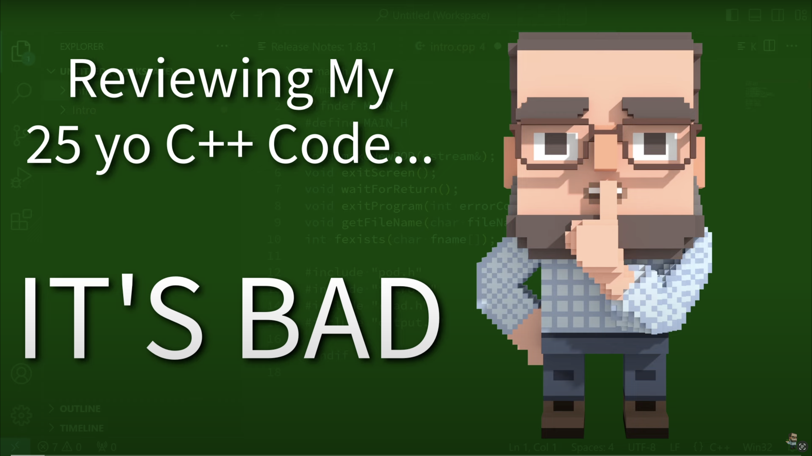
Cpp weekly
https://www.youtube.com/@cppweekly/search

Slide 77
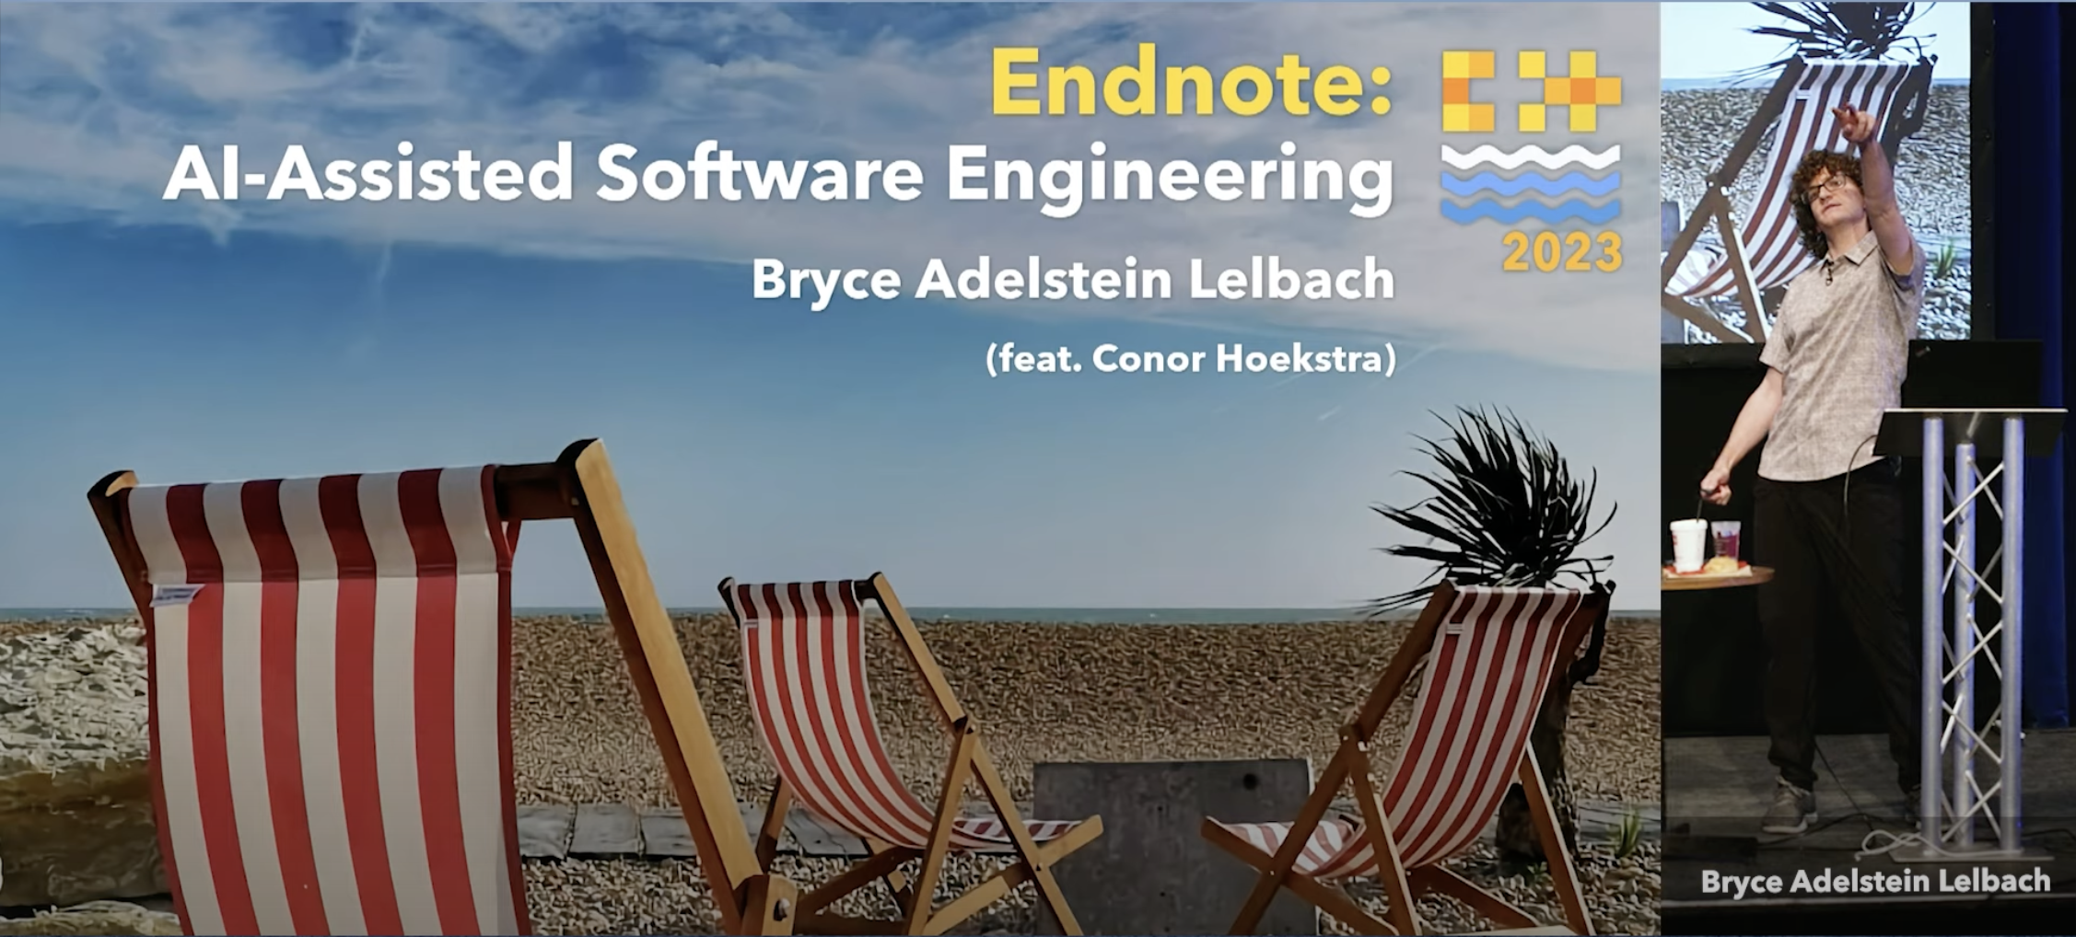
Ai tooling
https://youtu.be/19Sr8XhN0BM
https://github.com/plasma-umass/cwhy
Notes:
Bryce is pointing to the future. Cwhy is a tool built with Emery Berger and Nicolas van Kemp (and others...)

Slide 78
submit a talk!
Speaker Liaison
CppCon
Volunteer Liaison
ACCU
C++ Now
CppOnSea
https://www.linkedin.com/in/kevinbcarpenter/
Email: kevin.carpenter@live.com

